Slide 1

We are also here!
Re-minding of plants and nature
Dr. Suhajda Éva Virág
Rogers Foundation for Person-Centred Education

Slide 2
What is our picture of plants?
As a starter, let’s think about how are we thinking of plants. Do you think they are…
…mobile or immobile?
…active or inactive?
…reactive on non-reactive?
How are plants and animals and man different?
Plants can also be used as metaphors – trigger words, which brings a specific frames to mind

Slide 3
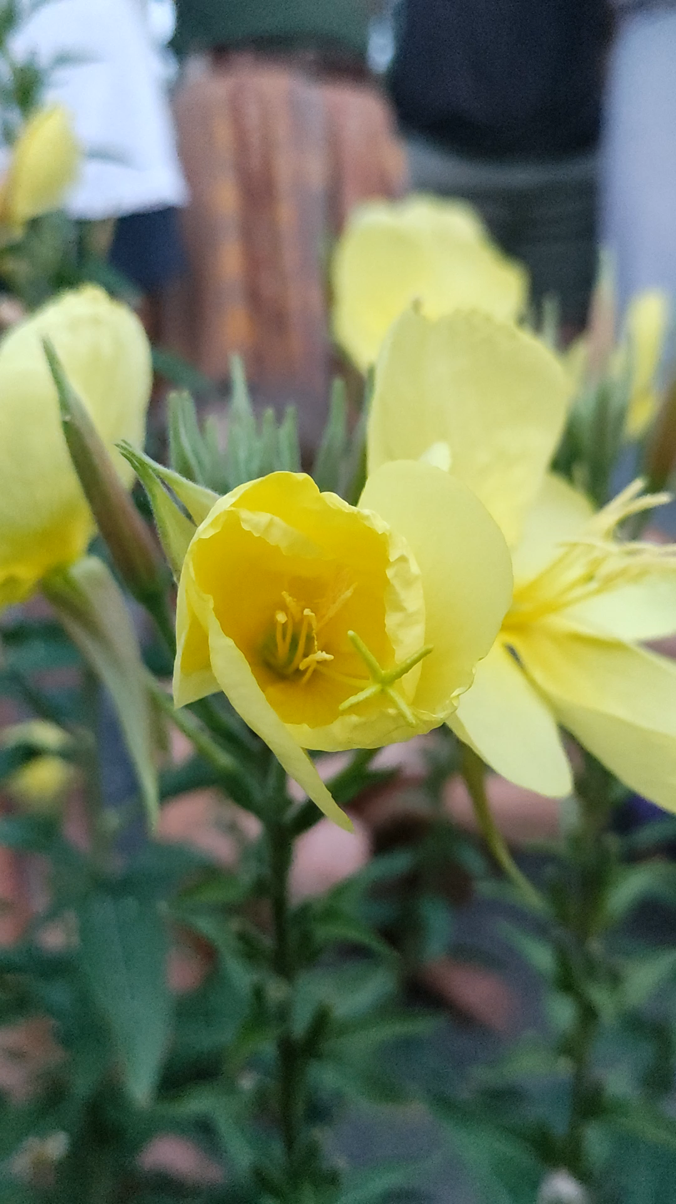
If you thought plants are immobile, look at this video of a moving Oenothera biennis:

Slide 4
If you thought plants are inactive and non-reactive, check out this video of a mimosa:
https://www.youtube.com/watch?v=0YrjJbRpMw8&ab_channel=Blondy2Hajni
Plants can and do react to environmental effects!

Slide 5
Our language on plants matter
Language development is an embodied process (Lakoff et al) - we formulate the meaning through our bodily (physical) experiences
Impersonalization removes physical experiences: it shows the object of focus as part organizational structures or processes (Fairclough)
  Look at the examples! How is the same plant descibed? Look for verbs! What the plant is doing in each text?
  (see the Handout of the PAPPUS Training Guide page 74 – Module 6, Activity 1)

Slide 6
Re-minding
„explicitly calling attention to the erasure of an important area of life in a particular text or discourse demanding that it be brought back into consideration” (Stibbe, 2015:164).
“a new way of speaking, one that enacts our interbeing with the earth (…) A style of speech that opens our senses to the sensous” (Abram 2010:3)
to give „salience” to these area, which means it gives it importance and proves its worth for attention.
“We can be ethical only in relation to something we can see, feel, understand, love, or otherwise have faith in” (Aldo Leopold

Slide 7
Re-minding children of nature through language
- Through reading poems : Look for a poem from your native language which describes plants!
Through listening to stories and tales
Through writing and perfoming

Slide 8
Task – for a group exercise
Find a plant in the yard that draws your attention
Write a poem or a very-very short story about it. It can be just a short one, as a haiku:
  Containing descriptions, sensible experiences regarding the plant
  Containing emotions that the plant draws from you
Share it in the group and decide with which you work together
Make a picture / set of pictures together about your poem or story for the kamishibai
Present it to the group

